Slide 1
LINGUISTIC ANALYSIS OF DESCRIPTIONS OF CLINICAL CASES
IN ENGLISH LITERATURE
Выполнила: студентка 2го курса
Лечебного факультета
группы 203(2)
Эмирвели Сабрие

Slide 2
My article is devoted to the linguistic analysis of dialogues between doctors and patients.
The doctor should be respectful, friendly, tactful. He should not interrupt the patient unless necessary. You should give him the opportunity to talk about what worries and why he went to the doctor. You also need to monitor the reactions and take them into account, take an interest in the patient's opinion, doubts, fears. Do not use special terminology, but replace terms with common words or immediately provide an explanation.
Using the dialogues as an example, I examined the caution with which doctors present information to the patient's relatives and what analysis criteria are presented

Slide 3
The issue of the importance of proficiency in English for the physician was considered.
Knowing a foreign language, a doctor can share his experience, hold meetings with colleagues from other countries, thus establishing international scientific ties.

Slide 4
Medical experience is the reason that medical workers begin to write works of art in which the image of the doctor is deeply revealed, his inner world is conveyed, the theme of the relationship between a specialist and a patient is reflected, as well as issues of modern medicine are raised.
.
The urgency of the problem lies in the fact that works about doctors educate students of medical universities in a foreign language communicative competence, love for people, the ability to compassion, educate mercy and disinterestedness. The image of a doctor, present on the pages of our works, gives us the opportunity to assert that the profession of a doctor is in demand.

Slide 5
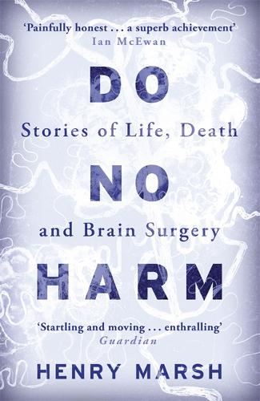
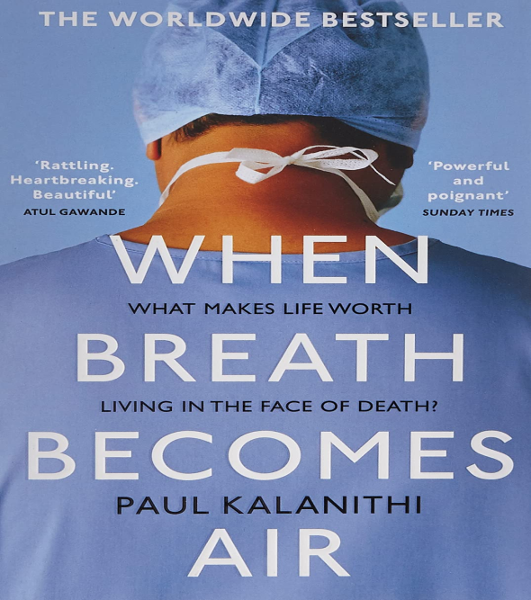
The purpose of the article is a linguistic analysis of the description of clinical cases using the example of English-language literary texts. The material for analysis is the books: Henry Marsh "Do No Harm", Paul Kalanithi "When Breath Becomes Air" and M. Ford “Hold My Hand".
I analyzed 7 dialogues of each of the texts, namely the definition of linguistic means: synonyms, paronyms, antonyms and metaphors.
Henry Marsh
Paul Kalanithi
M. Ford
"Do No Harm",
"When Breath Becomes Air"
«Hold My Hand»

Slide 6
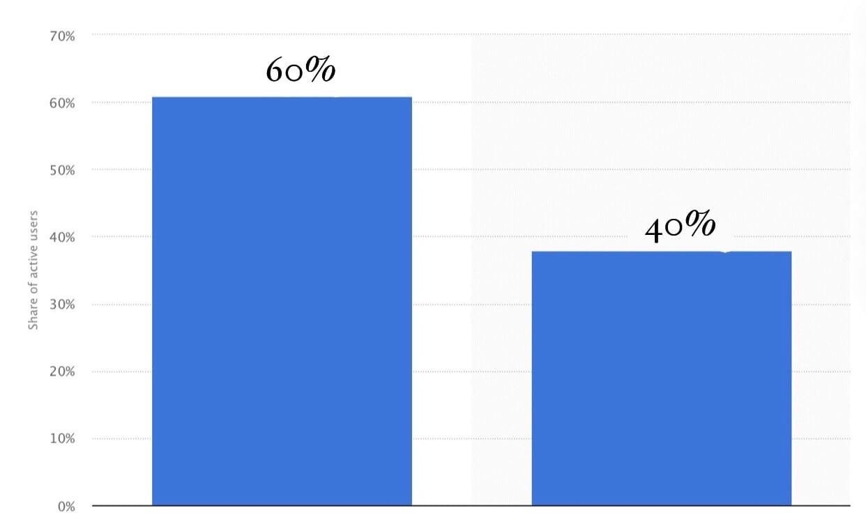
In the process of performing the work, a survey was conducted of 60 students of 17-22 years old, according to the results of which a confirmation of the relevance and research and significance of English-language medical texts in the process of the formation of the linguistic personality of a doctor was obtained. 60% believe that fiction is a small step towards becoming a competent specialist. The remaining 40% of the respondents believe that in order to be competent in their profession, it is necessary to read scientific literature and not refer to fictional characters. In my opinion, many problems in medicine can be seen in books, since doctors write works based on their life experience. In addition, a person enriches his vocabulary, that is, literacy.

Slide 7
The results of the article confirm that most people read fiction and become familiar with linguistic means, which contributes to enrichment of speech. The authors, in turn, use synonyms, antonyms, paronyms and metaphors in different ways, or do not use them at all.
Linguistic analysis of the text made it possible to illustrate the richness of the linguistic units used in literary texts describing medical practice

